Slide 1

Writing Your Résumé
Career Center
Workshop- Nursing

Slide 2
What is a Résumé?
A marketing tool – you are marketing yourself
A brief overview of education and relevant activities to demonstrate skills and accomplishments
A document tailored to each position / organization
The first (and maybe the only) impression
Notes:
Remind students before starting workshop:
There is no right or wrong résumé.
The following are guidelines, not rules.
The employer should to be able to see how your qualifications match with
the position. Put yourself in their frame of reference. They need to know why they
are reading this résumé.
Remind students to continue to update their résumé as they gain more experience.
Writing a résumé is a life skill to master, not a one-time event

Slide 3
ID Places That Hire LVNs
Skilled nursing facilities
Home healthcare agencies
Hospice
Clinics & hospitals (e.g., Cottage)
Doctor’s offices
SB School District

Slide 4
Résumé Writing Guidelines
Résumés are subjective– few true rules
  What you include & HOW you include it, has an impact
YOU MUST TELL THE TRUTH!!
Prioritize the information in order of interest to your reader– top left is highest emphasis
Notes:
Story about lying and getting busted
What you have to offer is in terms of skills – not a listing of past jobs
Highlight minimum requirements listed for job.
Focus résumé on target skills being looked for in recruitment / vacancy announcement.

Slide 5
Linking Yourself to the Position
Match YOUR skills & qualifications to THEIR requirements and keywords
Critique your résumé as if YOU were the employer– what would YOU want to see?
This is the single most important aspect of résumé writing!
Notes:
Make it clear to the employer why you want to work there (goals!) particularly if your past
experience doesn’t lead directly to their position by understanding organization’s
culture / mission / values and communicating how you can contribute

Slide 6
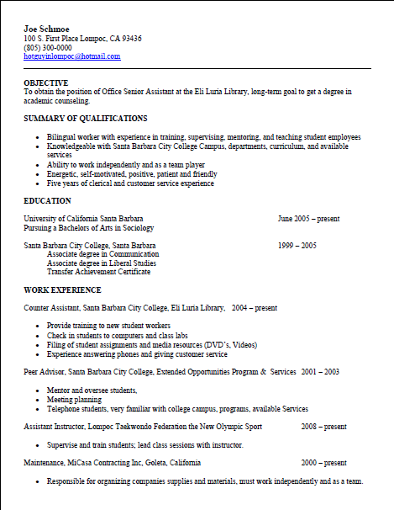
What does a résumé look like?

Slide 7
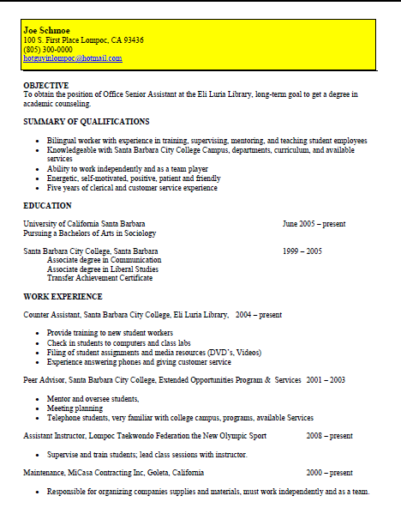
Parts of a Résumé : Contact Info
Emphasize your Name
Use a local address if reliable
Phone numbers: use cell phone number if you have a professional voice mail greeting
Provide appropriate e-mail address (NOT lazyboybob@...) and check on a daily basis
Recommend 10-12 font size for contact information and remainder of résumé

Slide 8
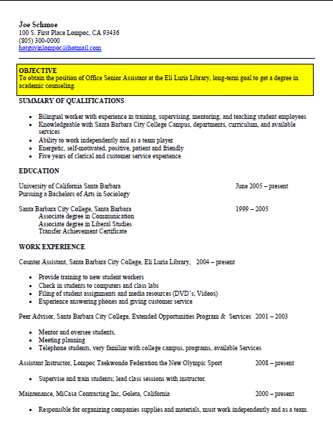
Parts of a Résumé: Objective Statement
Type 1 (for specific position)
I want a job at an assisted living facility which will value me and allow me to grow and gain experience. (Wrong focus…)
vs. direct…
  Licensed Vocational Nurse at Casa Dorinda
  To secure position as a medical administration nurse for Valle Verde ...

Slide 9
Parts of a Résumé: Objective Statement
Type 2 (for skills you bring)
  To secure a position utilizing my strong patient care and organizational skills to make a significant contribution in medical care activities
  To contribute to a health care center that can use a dedicated and hard working medical professional with exceptional communication and organizational skills

Slide 10
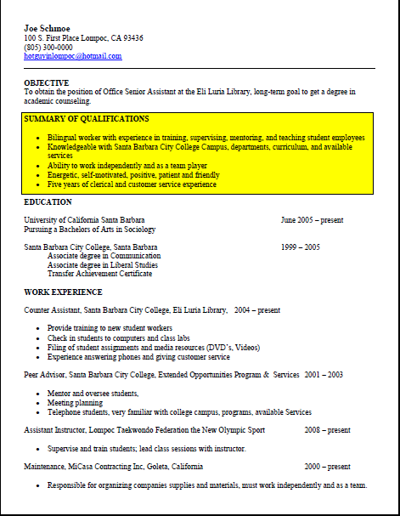
Parts of a Résumé:
Summary of Qualifications
Highlight your own personal strengths & the job requirements (adept at all aspects of basic patient care, medical charting, compassionate, bilingual, excellent organizational skills...)
Not too many items (Roughly 4-5)
Compare with job description
Relate to the objective (“extra” value that is related to position or shows some growth OK; e.g. supervisorial experience)
Notes:
Resume IS a skills section
Make as consistent as possible with Experience
Be careful here for redundancy or irrelevance.

Slide 11
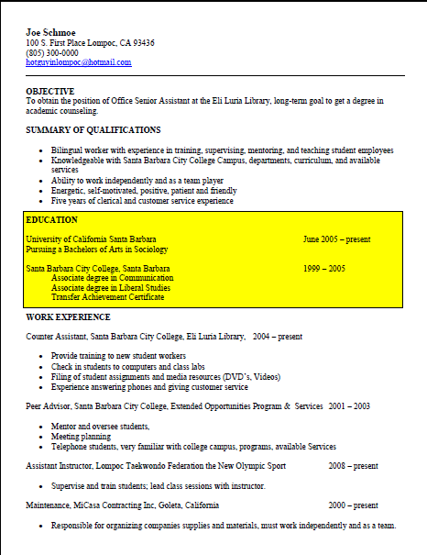
Parts of a Résumé: Education
Don’t underestimate how important your education is
Think in terms of skills and experience... Describe rotations/internships like professional experience
Include degree, certifications, license, relevant coursework, GPA only if exemplary (honors, top student)
Notes:
Don’t short change yourself
90% of student resumes skimp on the emphasis of education.
Many local employers WANT to hire SBCC students

Slide 12
Education Example
Licensed Vocational Nursing, Santa Barbara City College, Santa Barbara, CA, June 2014
Honors: 3.6 GPA, Dean’s List (2 terms)
Clinical Rotations: ...
Special Projects: ....

Slide 13
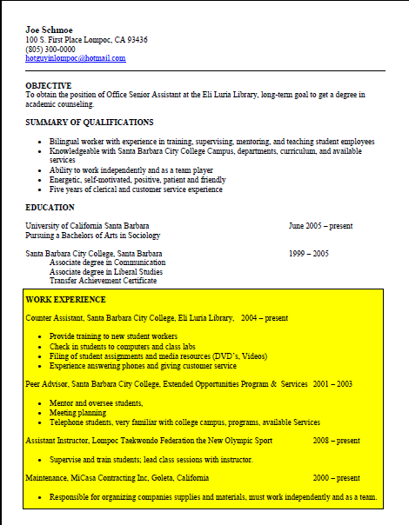
Parts of a Résumé: Experience
BE CONSISTENT
Include: Title, Organization, City, State, Dates
Include accomplishments rather than duties in bullet form
If your job title is not descriptive, consider replacing it with a functional title (Student Worker III = Asst Mgr of Computer Lab)
Notes:
Be consistent
Take liberties with jobs title and description but always TELL THE TRUTH

Slide 14
Chronological
ADVANTAGES
Most common & traditional style
Employers find it easy to understand
Generally easier to write
Emphasizes career laddering
DISADVANTAGES
Most recent experience may not be your most important
Little or no work experience or seemingly unimpressive
Notes:
Be consistent
Take liberties with jobs title and description but always TELL THE TRUTH

Slide 15
Chronological Example
(bullet or paragraph)
Certified Nursing Assistant, Assisted Health Care, Santa Barbara, CA, 8/10-8/12
Provided patient care, administered medications, assisted with activities of daily living including body mechanics, nutrition and safety.
Receptionist, Wood Glen Hall, Santa Barbara, CA 8/07 - 8/10
Provided friendly, efficient customer service. Answered phones, updated resident information (data entry), kept track of visitors and over 50 residents coming in and out, posted events.
Notes:
Be consistent
Take liberties with jobs title and description but always TELL THE TRUTH

Slide 16
Functional
ADVANTAGES
Useful to emphasize abilities not used in recent work experience
Useful when changing careers or entering the job market for the first time
DISADVANTAGES
May be more difficult to write
May be confusing to employer or create scepticism due to lack of content
Notes:
Be consistent
Take liberties with jobs title and description but always TELL THE TRUTH

Slide 17
Look and Feel…
Be clear in your style
Be consistent in your fonts and in your margins
        and spacing
Check for typos and attention to detale and mispelled wrods

Slide 18
Résumé Formatting
Chronological? Functional? Combination?
Length: ONE PAGE?
Font and margin considerations
Choose bold type, italics, or caps to highlight important information
Your résumé should be NEAT, PROFESSIONAL and EASY TO READ
Absolutely NO typographical errors!
Notes:
Review postal, scannable, attachments, internet, email concerns –
refer to pp. 8-9 in résumé book
(don’t rely on attachments, wise to send information in body of e-mail text)
Format:
one page usually works well for recent graduates
At least one inch margins, font size… 11/12?
paper type – 20 lb., colors
templates ? (individuality issues)
Notes about taking risks with format – understand your choices to be prepared to defend them
Proofread! And Proofread again – you don’t want any errors!
Have someone else read your résumé and the job
announcement, put it down and come back to it,
make changes based on feedback

Slide 19
Describing Work Experience
Focus on accomplishments, not routine duties
Use ACTION verbs – created, managed, coordinated...
Use numbers (numerals) whenever you can: $9800,
28 clients, 45%
Use a superlative whenever you can: first, best,
fastest, largest
Write long on your first draft - you can edit later

Slide 20
Parts of a Résumé: Other Sections
Campus/Community Involvement
  This is one example...think of some of your own
References
  They are assumed; use the space to expand on your qualifications
  Create a reference list (with professional and/or scholastic contacts) to give them when they do ask, but not before.
Notes:
Is this working for you?

Slide 21
Do Don’t
Emphasize your name
Be consistent
Use numbers
Match keywords to the job posting
Describe projects
TELL THE TRUTH!
Use the word “I”
Use fluff phrases– e.g., Responsible for, Duties include, etc.
Use graphics or colors or photos
Allow ANY spelling or grammar errors

