Slide 1

Writing Your Résumé
A Résumé Workshop

Slide 2
What is a Résumé?
A marketing tool – you are marketing yourself
A brief overview of education and relevant activities to demonstrate skills and accomplishments
A document tailored to each position / organization
The first (and maybe the only) impression

Slide 3
Résumé Writing Guidelines
Résumés are subjective– few true rules
  What you include & HOW you include it, has an impact
YOU MUST TELL THE TRUTH!!
Prioritize the information in order of interest to your reader– top left is highest emphasis

Slide 4
Linking Yourself to the Position
Match YOUR skills & qualifications to THEIR requirements and keywords
Critique your résumé as if YOU were the employer– what would YOU want to see?
This is the single most important aspect of résumé writing!

Slide 5
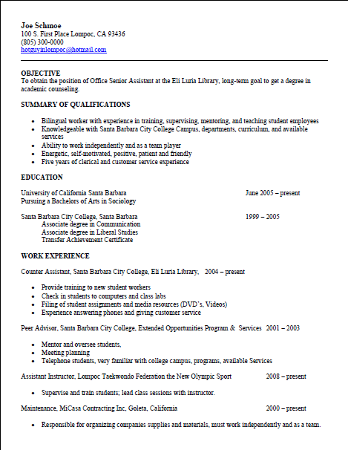
What does a résumé look like?

Slide 6
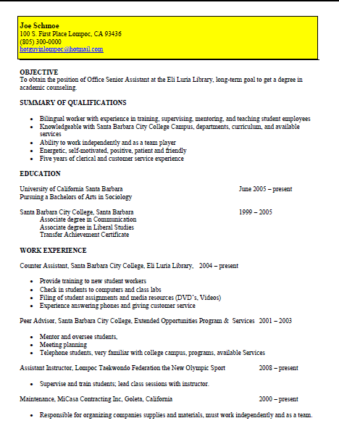
Parts of a Résumé : Contact Info
Emphasize your Name
Use a local address if reliable
Phone numbers: use cell phone number if you have a professional voice mail greeting
Provide appropriate e-mail address (NOT lazyboybob@...) and check on a daily basis
Recommend 11 or 12 font size for contact information and remainder of résumé (Times New Roman, Garamond, Gill Sans)
Notes:
https://designschool.canva.com/blog/resume-fonts/

Slide 7
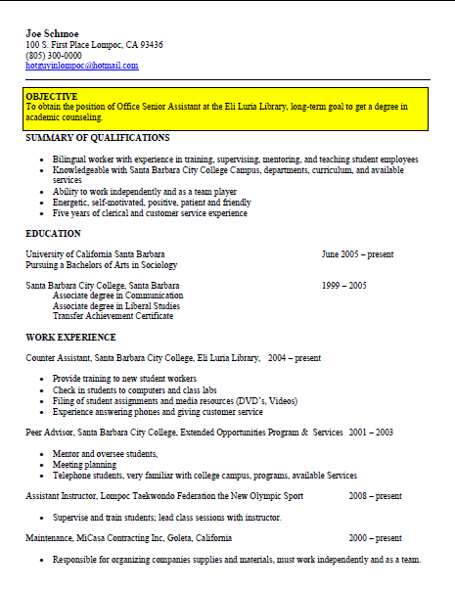
Parts of a Résumé: Objective Statement
I want a job with a company who will value me and allow me to grow and gain experience.
vs.
Seeking an engineering position with AMD where I can utilize my ability to analyze, interpret and evaluate data, conduct research, prepare and write reports.
Or simply: Seeking an electrical engineering position with AMD

Slide 8
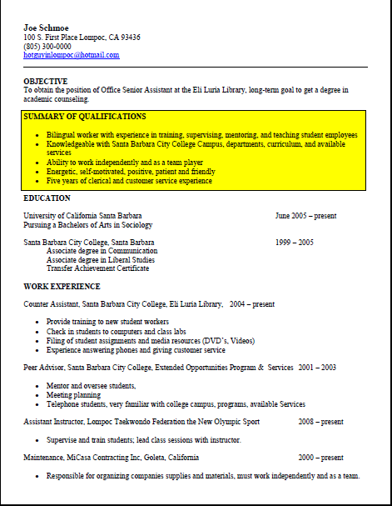
Parts of a Résumé:
Summary of Qualifications
Summarize your key strengths for the position
Not too many items (Roughly 3-5)
Be specific – paint a picture
This area should be ESPECIALLY tailored to position
Speak THEIR language

Slide 9
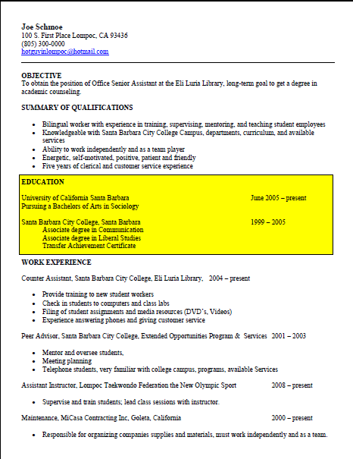
Parts of a Résumé: Education
Don’t underestimate the importance of your education on your résumé
Think in terms of skills and experience...just like describing professional experience
List coursework and projects when applicable
SBCC can be your calling card

Slide 10
Education Example
Santa Barbara City College, Santa Barbara, CA
A.S., Engineering
Expected date of graduation: 5/2018
Honors: 3.6 GPA, Dean’s List (2 terms)
Related Coursework: Mechanics of Solids & Fluids, Electricity & Magnetism, Statics & Strength Materials
Special Projects: Satellite Project, Spring 2016
Designed low earth orbit, low-power, lightweight satellite among group of four.
Utilized satellite software STK and MATLAB to complete calculations
Achieved goal with satellite of 175 km orbit, 1.15 kW-hr power usage, 155 kg weight

Slide 11
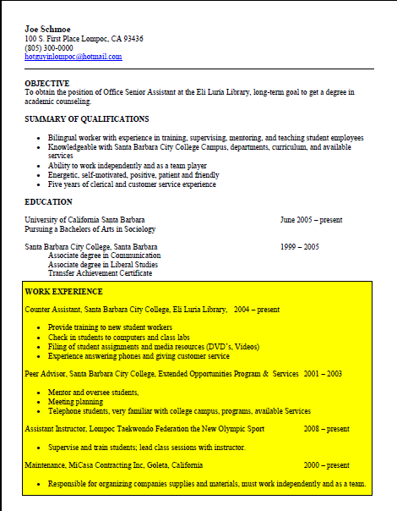
Parts of a Résumé: Experience
BE CONSISTENT
Include: Title, Organization, City, State, Dates
Include accomplishments rather than duties in bullet form
If your job title is not descriptive, consider replacing it with a functional title (Student Worker III = Asst Mgr of Graphics Lab)
Note: Your degree is your “job title” under Education (i.e. AA, Graphic Design)

Slide 12
Describing Work Experience
Focus on accomplishments, not routine duties
Use ACTION verbs – created, managed, coordinated...
Use numbers (numerals) whenever you can: $9800,
7 clients, 45%
Use a superlative whenever you can: first, best,
fastest, largest
Write long on your first draft - you can edit later

Slide 13
Take a Management Point of View
Provide budget data even if that did not personally interest you
Show some understanding of how your task fit into the company’s overall goals
“Resulted in 5% reduction in inventory due to more efficient logistics, representing a one-time $5,000,000 savings to company
Are you contributing to the “bottom line”?

Slide 14
Experience Example (Not so good)
2014-2016 Swersky Construction, Santa Barbara, CA
Bob Swersky, Supervisor
1235 Overlook Drive
805-620-7314
Laborer– hammered nails, thumbs; mastered expletives

Slide 15
Experience Example (Good)
Construction Crew Assistant, Swersky Construction, Santa Barbara, CA Summers 2014-2016
  Coordinated with crew of 4 to build homes
  Rapidly adapted to changing work orders
  Maintained tools worth over $1000
  Beginning training in reading blueprints and structural requirements

Slide 16
Parts of a Résumé: Other Sections
Campus/Community Involvement
  This is one example...think of some of your own
References
  They are assumed; use the space to expand on your qualifications
  Create a reference list (with professional and/or scholastic contacts) to give them when they do ask, but not before.

Slide 17
Résumé Formatting
Chronological? Functional? Combination?
Length: ONE PAGE?
Font and margin considerations
Use bold type, italics, or underlines to highlight important information
Your résumé should be NEAT, PROFESSIONAL and EASY TO READ
Absolutely NO typographical errors!

Slide 18
Chronological Format
Advantages
  It’s the most common & traditional style.
  Employers find it easy to understand.
  It’s generally easier to write.
  It emphasizes career laddering.
Disadvantages
  Your most recent experience may not be your most important or relevant experience.
  Some students may have little or no work experience or feel their work experience is unimpressive.
  Some people don’t want to be stereotyped on the basis of their past work experience.

Slide 19
Functional Format
Advantages
  Useful when you want to emphasize abilities not used in recent work experience.
  May be useful when entering the job market for the first time or changing careers.
Disadvantages
  May be difficult to write.
  May be confusing to employer or create skepticism due to lack of content.

Slide 20
Do Don’t
Emphasize your name
Be consistent
Use numbers
Match keywords to the job posting
Describe projects
TELL THE TRUTH!
Use the word “I”
Use fluff phrases– e.g., Responsible for, Duties include, etc.
Use graphics or colors or photos
Allow ANY spelling or grammar errors

Slide 21
Writing Your Cover Letter

Slide 22
3 Parts
Introduction
Specify the job you are interested in
Rationale or “Pitch”
Set yourself apart from others
Call to Action
Tell what you want to happen next

Slide 23
How can you make your Cover Letter stand out above the rest?
Address it to the person who is hiring
Show that you know about the company
Express enthusiasm
Check for spelling and grammatical errors
Set yourself apart
Be specific
Take the initiative about your next steps
Keep it brief (1 page, 3 – 5 paragraphs at the most)

Slide 24
Address & Salutation
Use Formal Address Style
Santa Barbara City College
Human Resources
Attn: Yvette Dicierdo
721 Cliff Drive
Santa Barbara, CA 93109-2394
Dear Ms. Decierdo,

Slide 25
Introduction
Grab the Employer’s Attention!
I am a recent graduate of Santa Barbara City College (or student attending)…
I am interested in the opportunity to work at Nordstrom. I have past experience working in retail…
I got your name from Jane Smith, Director of Marketing, at XXXX Company…

Slide 26
Rationale or “Pitch”
Impress with your Accomplishments and Talents
My high grades demonstrate my abilities and desire to perform well.
Although I am a first year student, I have worked 3 years in retail.
I am fluent in two languages.

Slide 27
Call to Action
Thank you very much for your time. I will be calling you shortly to see if we can arrange a time to meet.
Thank you for your attention, and I look forward to speaking with you soon. My phone number is ….

Slide 28
Signature
Sincerely,
Marie Jones

Slide 29
Job Fair Dos and Don’ts
Do Don’t
Bring a neat & clean resume
Prepare to talk about yourself and your experience
Be actively engaged (take out earbuds!)
Choose companies to talk to prior to the fair if possible
Dress appropriately
Be afraid to approach recruiters; they are excited to meet you!
Be negative; instead, choose positive language
Interrupt a conversation between a student and employer; politely wait your turn

Slide 30
Be proud of all you have accomplished!
Come to the Career Center if you need help with your
résumé or cover letter.

