Slide 1
The Ideal Candidate: Résumé Basics
Career Center
Santa Barbara City College

Slide 2
What is a Resume?
A marketing tool– you are marketing yourself
A brief overview of education and relevant activities to demonstrate skills and accomplishments
A document tailored to each position and organization
The first (and maybe only) impression
Notes:
Remind students before starting workshop:
There is no right or wrong resume.
The following are guidelines, not rules.
The employer should to be able to see how your qualifications match with
the position. Put yourself in their frame of reference. They need to know why they
are reading this resume.
Remind students to continue to update their resume as they gain more experience.
Writing a resume is a life skill to master, not a one-time event

Slide 3
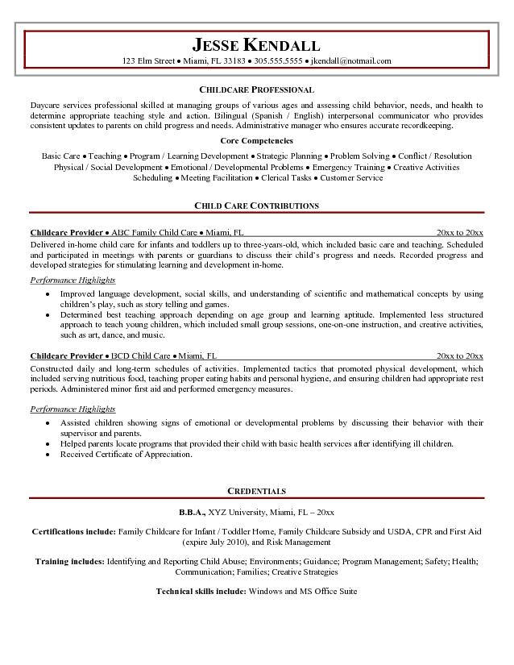

Slide 4
Resume Writing Guidelines
YOU MUST TELL THE TRUTH!!
Resumes are subjective– few true rules
What you include, and HOW you include it, has an impact
Prioritize the information in order of interest to your reader– top left is highest emphasis
Notes:
What you have to offer is in terms of skills – not a listing of past jobs
Highlight minimum requirements listed for job.
Focus resume on target skills being looked for in recruitment / vacancy announcement.

Slide 5
Linking Yourself to the Position
This is the key to success!
Match YOUR skills & qualifications to THEIR requirements and keywords
Critique your resume as if YOU were the employer– what would YOU want to see?
Notes:
Make it clear to the employer why you want to work there (goals!) particularly if your past
experience doesn’t lead directly to their position by understanding organization’s
culture / mission / values and communicating how you can contribute

Slide 6
Résumé and Interview Tool

Slide 7
Résumé Journal
You do amazing things every day in the ECE program
Often we forget experiences quickly, so documenting them is important
A resume journal is an informal list of experiences and accomplishments
This will make customizing your resume for specific positions much easier!

Slide 8
ePortfolios
An ePortfolio is a purposeful collection of work and information that:
represents an individual's efforts, progress and achievements over time
is goal-driven, performance-based and indicates evidence of the attainment of knowledge, skills and attitudes
includes self-reflection
is a tool for facilitating life-long learning and career development

Slide 9
Objective Statement Examples:
I want a job with a preschool who will value me and allow me to grow and gain experience.
Seeking a teaching position at the Children’s Center where I can utilize my curriculum design skills, bi-lingual (Spanish/English) abilities, and knowledge of language and cognitive processes of young children.
Notes:
Ask: Which would YOU prefer to see? Why?

Slide 10
Skills
Tailor skill headings to your own personal strengths & the job requirements (computer, language, lab, technical)
Don’t cite “hard worker, teamwork” etc.
Be specific when listing skills:
- Names of software, lab equipment, etc.
- Proficiency level of languages
Do you need a “Skills” section?
Notes:
Make as consistent as possible with Experience

Slide 11
Don't Forget About Education!
Many students underestimate how important their education is on their resume
Think in terms of skills and experience...just like describing professional experience
Are you acting like a professional?

Slide 12
Education Example
2016-present Santa Barbara City College
Currently studying Early Childhood Education
A.A., Early Childhood Education, Santa Barbara City College, Santa Barbara, CA, Expected 2019
ECE Units Completed: 12 units
Related Coursework: Child Developmental Psychology; Child, Family and Community
Special Projects: Developed online portfolio focusing on pre-kindergarten curriculum development

Slide 13
Experience
Be consistent with how you choose to organize and describe your experience.
Include:
Title, Organization, City, State, Dates
If your job title is not descriptive, consider replacing it with a functional title (Student Worker III = Asst. Child Care Provider)
Your degree is your “job title” under Education (i.e. A.A. Early Childhood Education)

Slide 14
Tips for Describing Experiences
Focus on accomplishments, not routine duties
Use ACTION verbs:
Use numbers (numerals) whenever you can: $9800, 7 children, 45%, 12 units
Use a superlative whenever you can: first, best, fastest, largest
Write long on your first draft-- you can edit later
Notes:
No fluff phrases– responsible for, duties include
Action words on pp. 11-12 of Career Center resume books
Thoughts on church-related/ political-related (possible controversial affiliations) activities – documenting effectively, focusing on skill type, possible discrimination, values conflict
Promotions, elevated responsibilities – handle money, reconcile funds,
make depositing, training
Emphasize your title
Resume Preparation Worksheet [HANDOUT]
1.) Ask everyone to complete page 1
2.) Ask for student to share example; have group help with example
3.) Focus on converting responsibilities and accomplishments to resume entry

Slide 15
Education Action Verbs
Achieved
Adapted
Advised
Clarified
Coached
Communicated
Conducted
Coordinated
Created
Critiqued
Designed
Developed
Directed
Established
Expanded
Enabled
Evaluated
Explained
Facilitated
Focused
Formulated
Guided
Headed
Implemented
Introduced
Individualized
Informed
Instilled
Instructed
Managed
Motivated
Organized

Slide 16
Education Action Verbs
Planned
Presented
Simulated
Stimulated
Structured
Taught
Tested
Trained
Transmitted
Tutored
Wrote
http://www.quintcareers.com/action_skills.html

Slide 17
Experience Example #1
2008-2015 Swersky Preschool, Goleta, CA
Linda Swersky, supervisor
1235 Overlook Drive
805-620-7314
Child care – Supervised large group of semi-civilized children
(UGH)

Slide 18
Experience Example #2
Teachers Aid, Swersky Preschool, Goleta, CA, Summers 2008-2015
Organized activities to develop language and vocabulary among children
Utilized audio visual aids in teaching to children
Coordinated with parents to communicate about their children’s development

Slide 19
Other Sections
Campus/Community Involvement
This is one example of a specialized Experience section, there are many others!
Training, Credentials, Affiliations, Profile, Portfolio, Activities, Languages,
References
They are assumed; use the space to expand on your qualifications
Create a reference sheet to hand them when they do ask, but not before

Slide 20
Resume Formatting
Length: ONE PAGE?
Font and margin considerations
Use underlines, bold type, and italics to highlight important information
Your resume should be NEAT, PROFESSIONAL and EASY TO READ
Absolutely NO typographical errors!
Notes:
Review postal, scannable, attachments, internet, email concerns –
refer to pp. 8-9 in resume book
(don’t rely on attachments, wise to send information in body of e-mail text)
Format:
one page usually works well for recent graduates
At least one inch margins, font size… 11/12?
paper type – 20 lb., colors
templates ? (individuality issues)
Notes about taking risks with format – understand your choices to be prepared to defend them
Proofread! And Proofread again – you don’t want any errors!
Have someone else read your resume and the job
announcement, put it down and come back to it,
make changes based on feedback

Slide 21
Do, or Do Not. There is no try.
DO:
Emphasize your name
Be consistent
Use numbers
Match keywords to the job posting
TELL THE TRUTH!
DO NOT:
Use the word “I”
Use fluff phrases– Responsible for, Duties include, etc
Use graphics or colors
Allow ANY spelling or grammar errors

